Slide 1
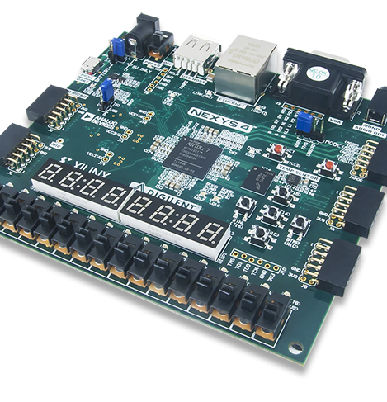
Lab 8
Group_D:
Laurice Sattouf
Choi Tim Anthony Young
Dimitri Garcia
Professor:
Mohamed El-Hadedy
California Polytechnic State University Pomona, California

Slide 2
Assignment
Display Text on Screen Via VGA
Make Available Control of Text Position via UART
Make Available Control of Text Colour via Switches

Slide 3
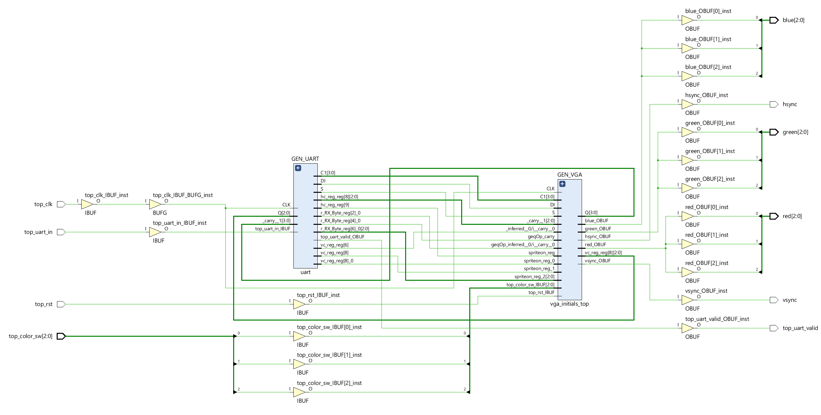
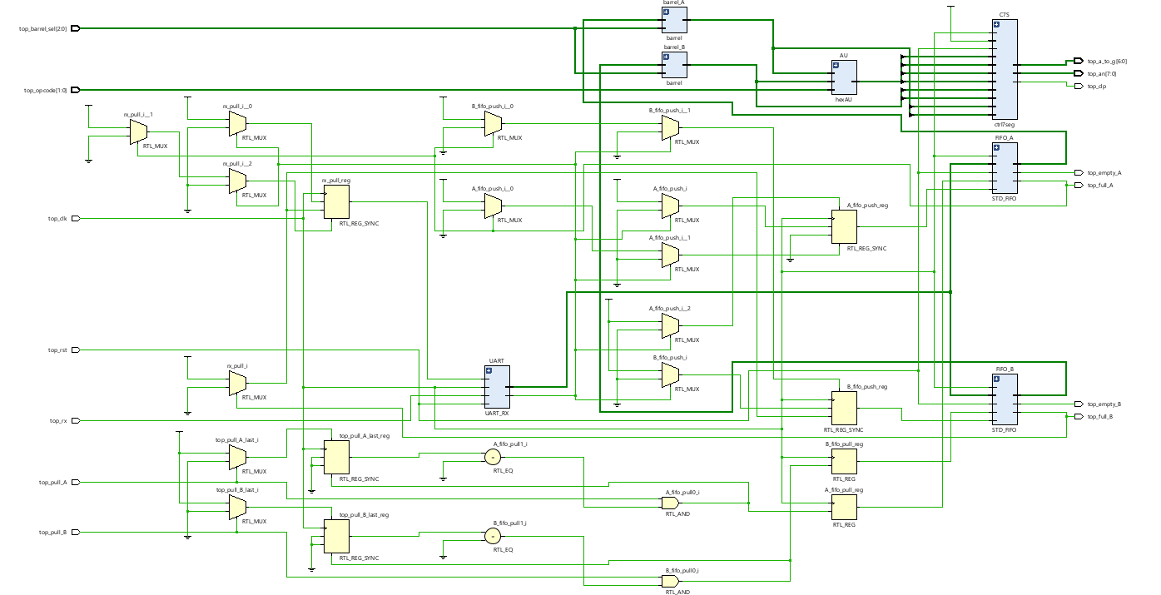
Schematic

Slide 4
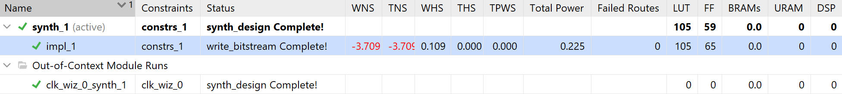
Power and Resources

Slide 5
Difficulties
There was not significant difficulties.

Slide 6

Work Distribution
We had a meeting to brainstorm and explain the main idea of the lab, and we work individually to attempt to achieve the most optimized design.
Documentation and reports were evenly distributed, and it covered all the steps of our successfully implemented design.

